Slide 1
OpenShift Installation

Slide 2
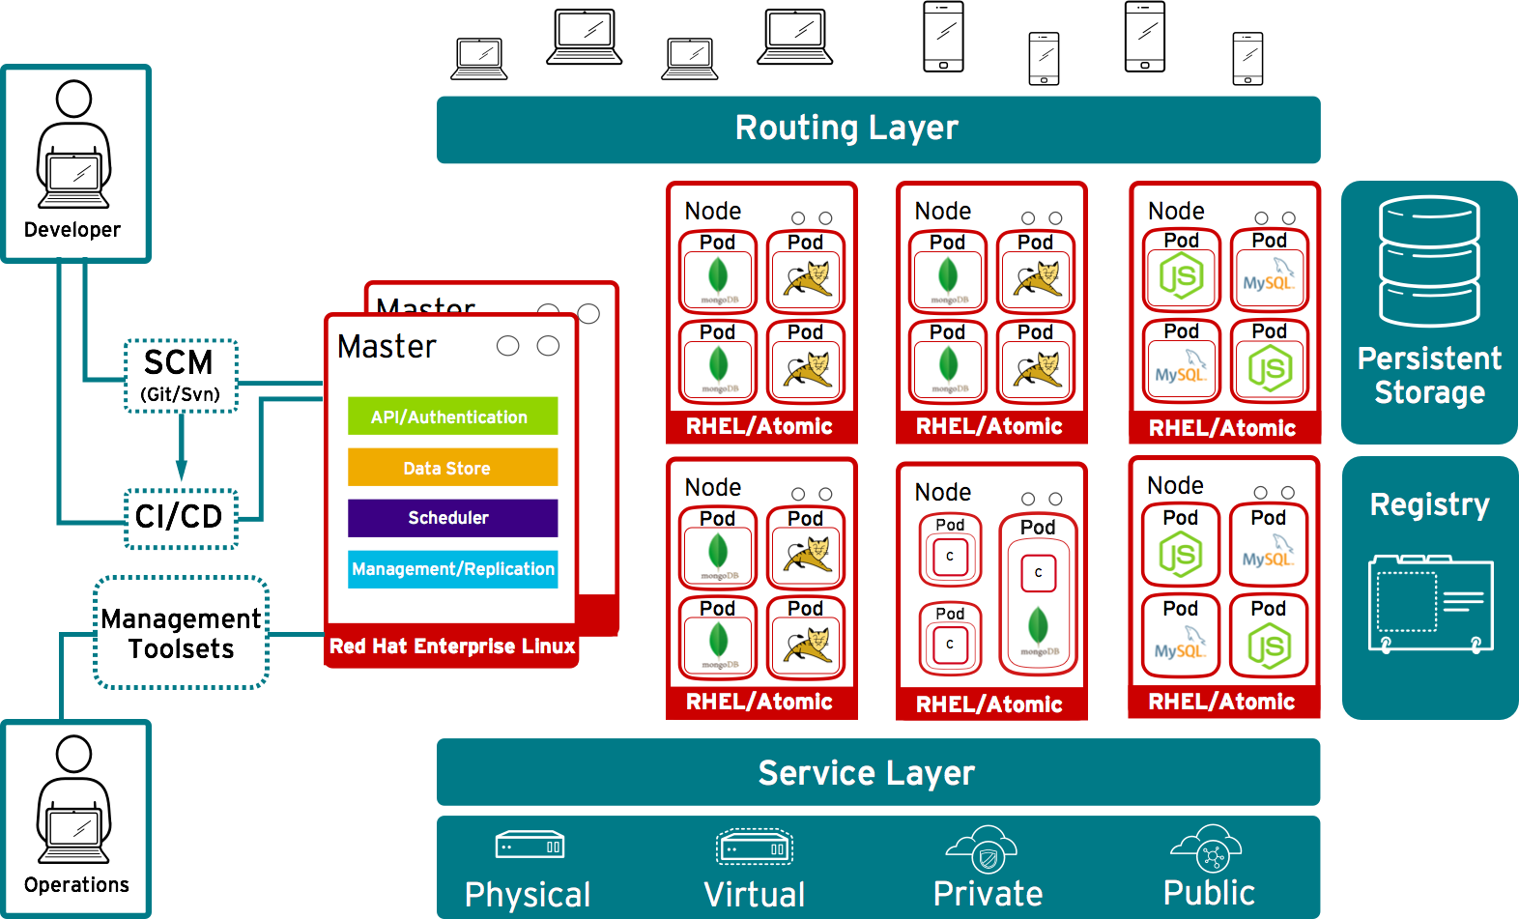
OpenShift Architecture

Slide 3
OpenShift 3.x

Slide 4

How to setup a OpenShift 3.x Cluster
Install Infra. Bastion (Ansible) Server & Satellite
RHEL 7 or ATOMIC
Control Plane
RHEL 7 or ATOMIC
3 Master Nodes
Regisitriy
Infra Nodes
RHEL 7 or ATOMIC
Router
Metric / Logging
Worker Nodes
RHEL 7 or ATOMIC
CNS (Optional)
Container Native Storage (Gluster)
RHEL 7 or ATOMIC
DIrect att. Disk

Slide 5
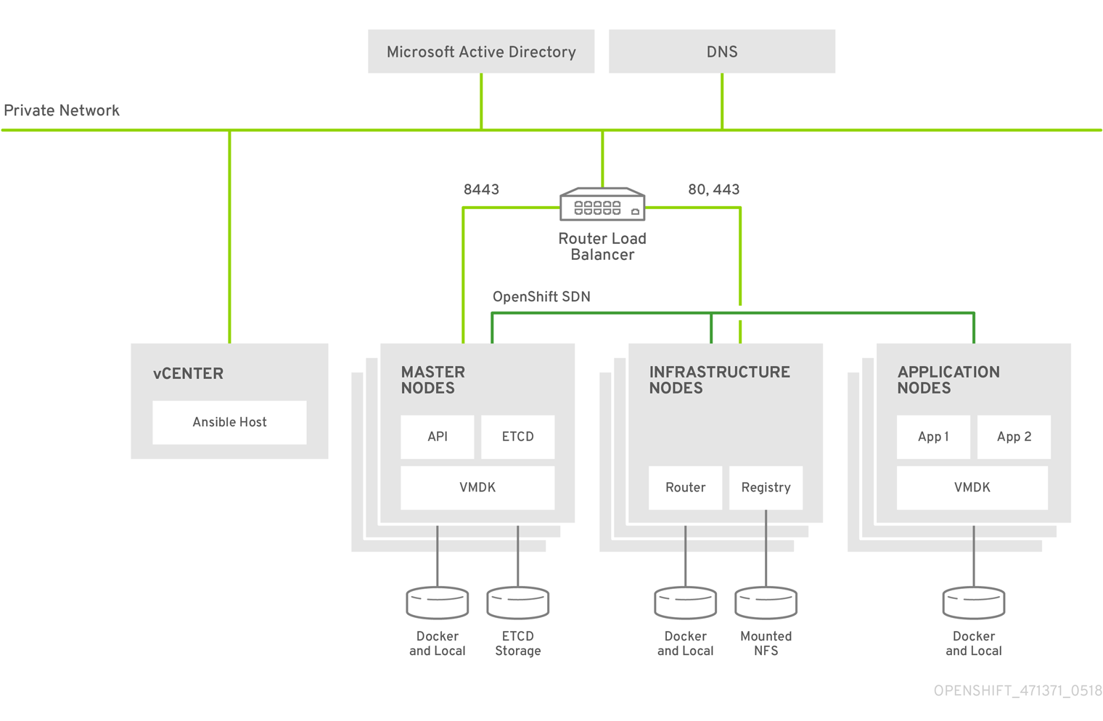
Virtual Environments
OCP Cloud Layout

Slide 6
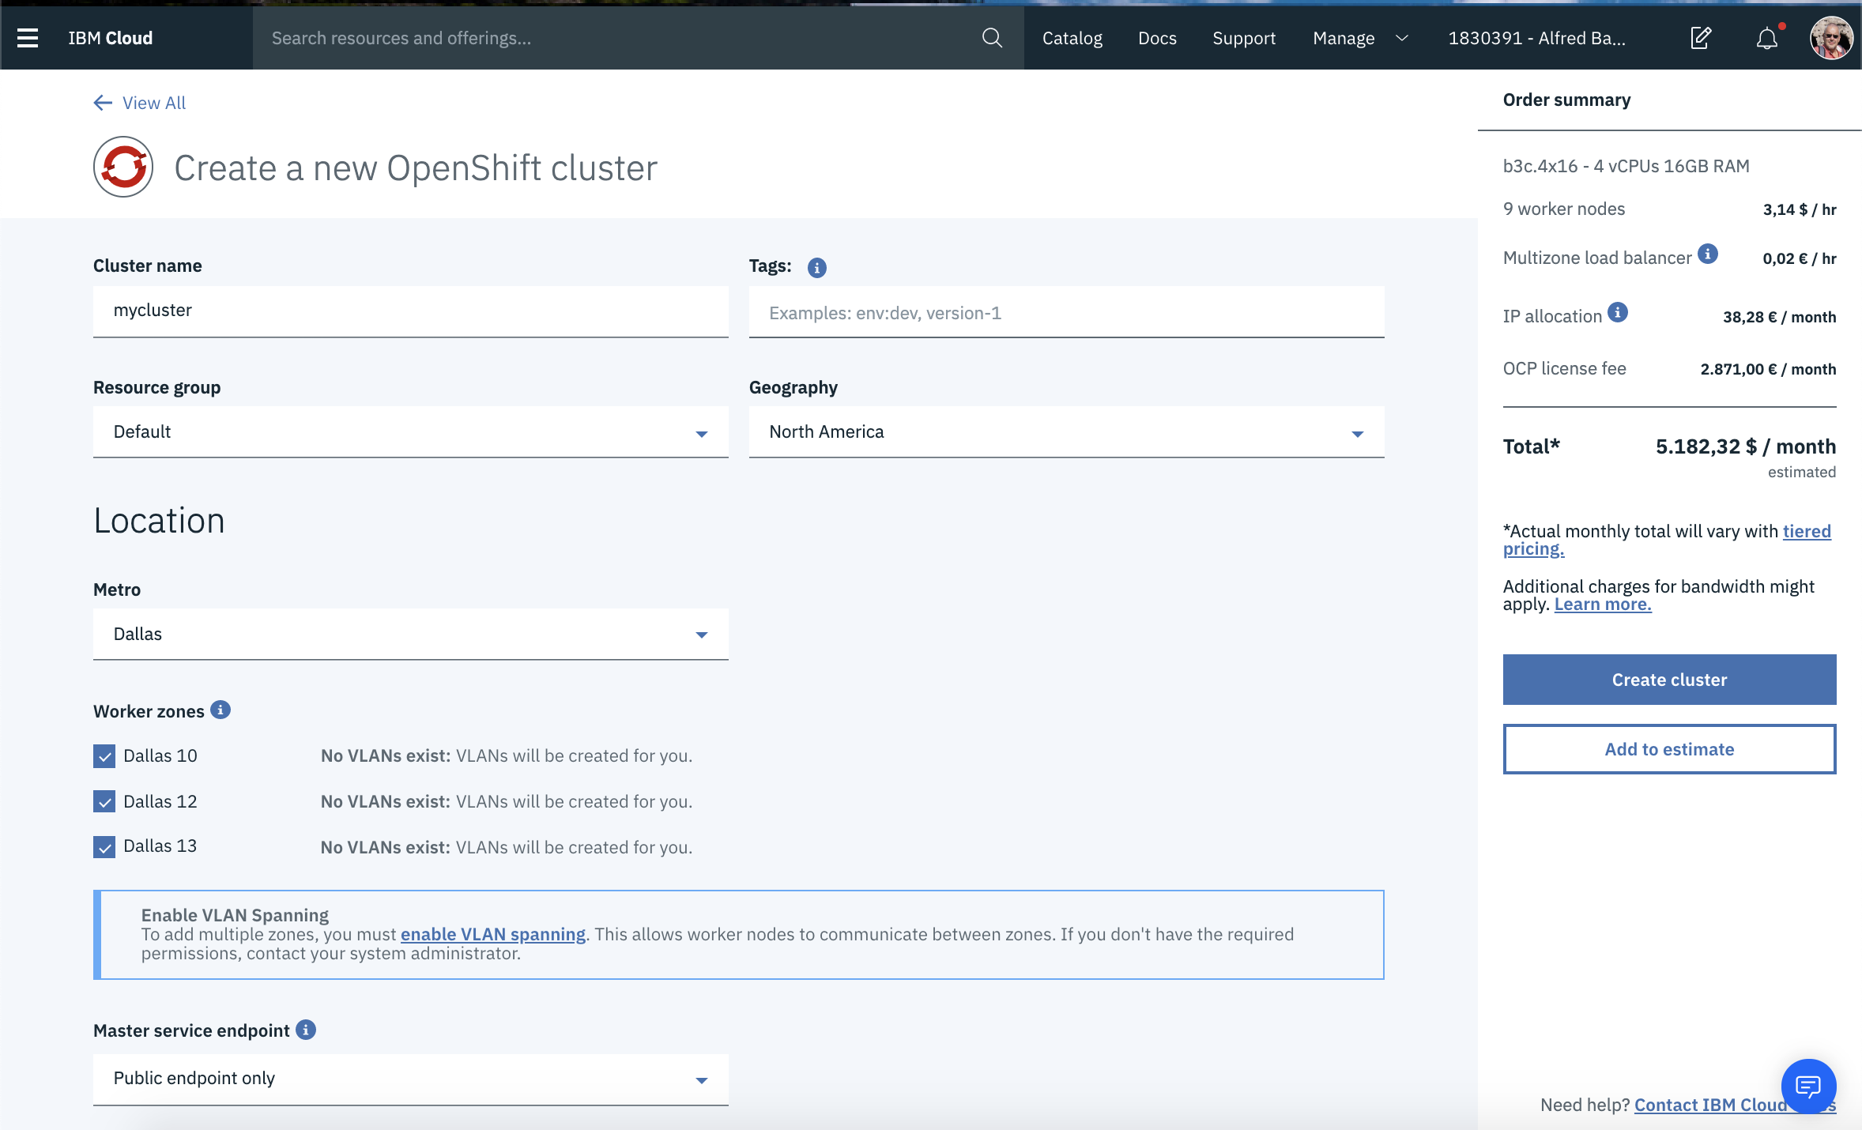
IBM Cloud Setup

Slide 7
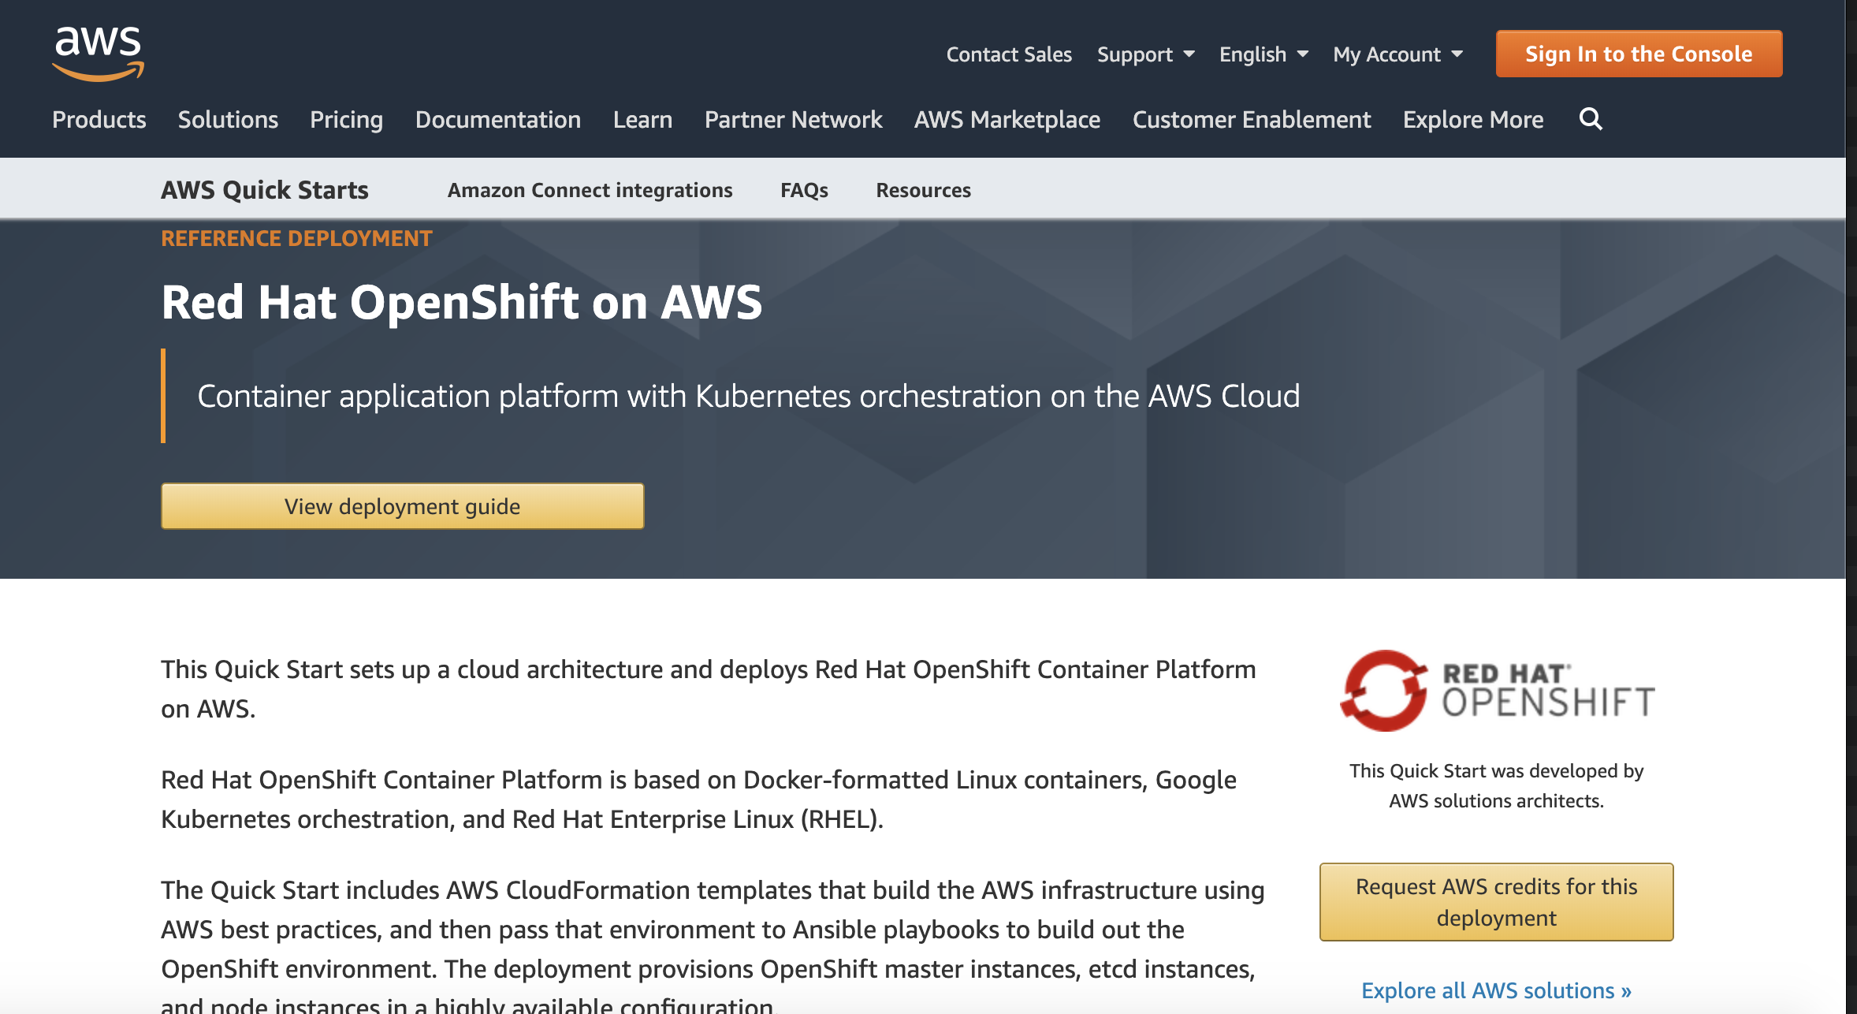
OpenShift on AWS

Slide 8
OpenShift 4.x

Slide 9
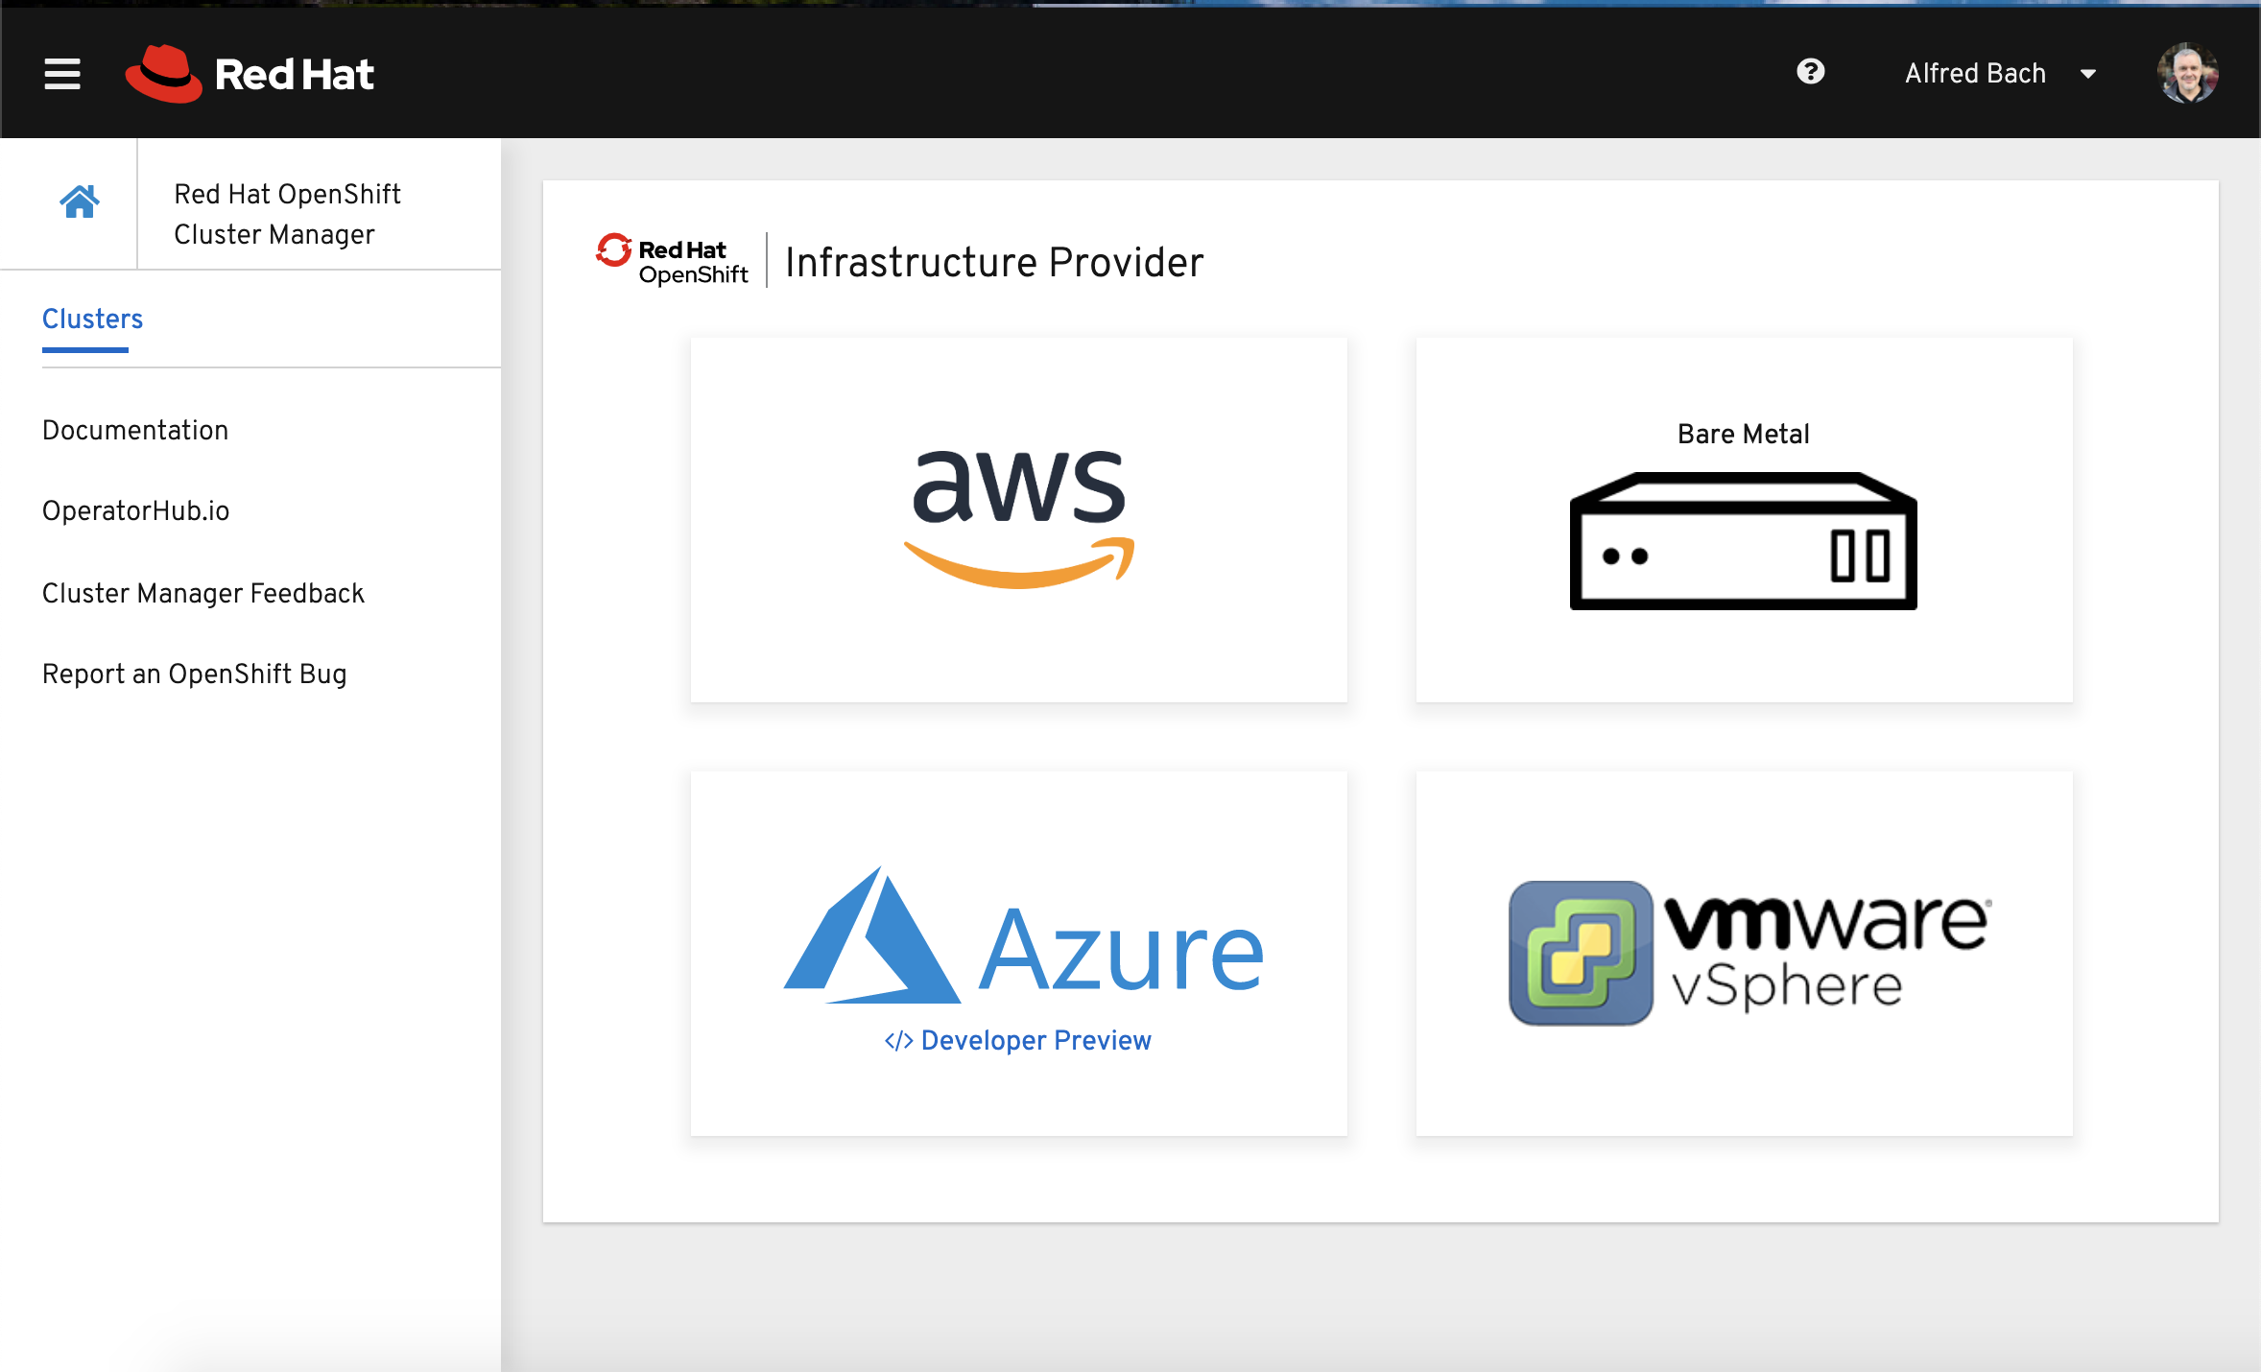
OpenShift 4 Installer

Slide 10
https://docs.openshift.com/container-platform/4.1/welcome/index.html

Slide 11
How to manual setup a OpenShift 4 cluster
Deployment Server
RHEL 8
Load Balacer
RHEL 8 HAPROXY BIND
Control Plane
CoreOS
3 Master Nodes
Registry
Worker Nodes
RHEL 7 or ATOMIC
CNS (Optional)
Container Native Storage (CEPH)
RHEL 7 or ATOMIC
DIrect att. Disk
Boot Strap
CoreOS

Slide 12
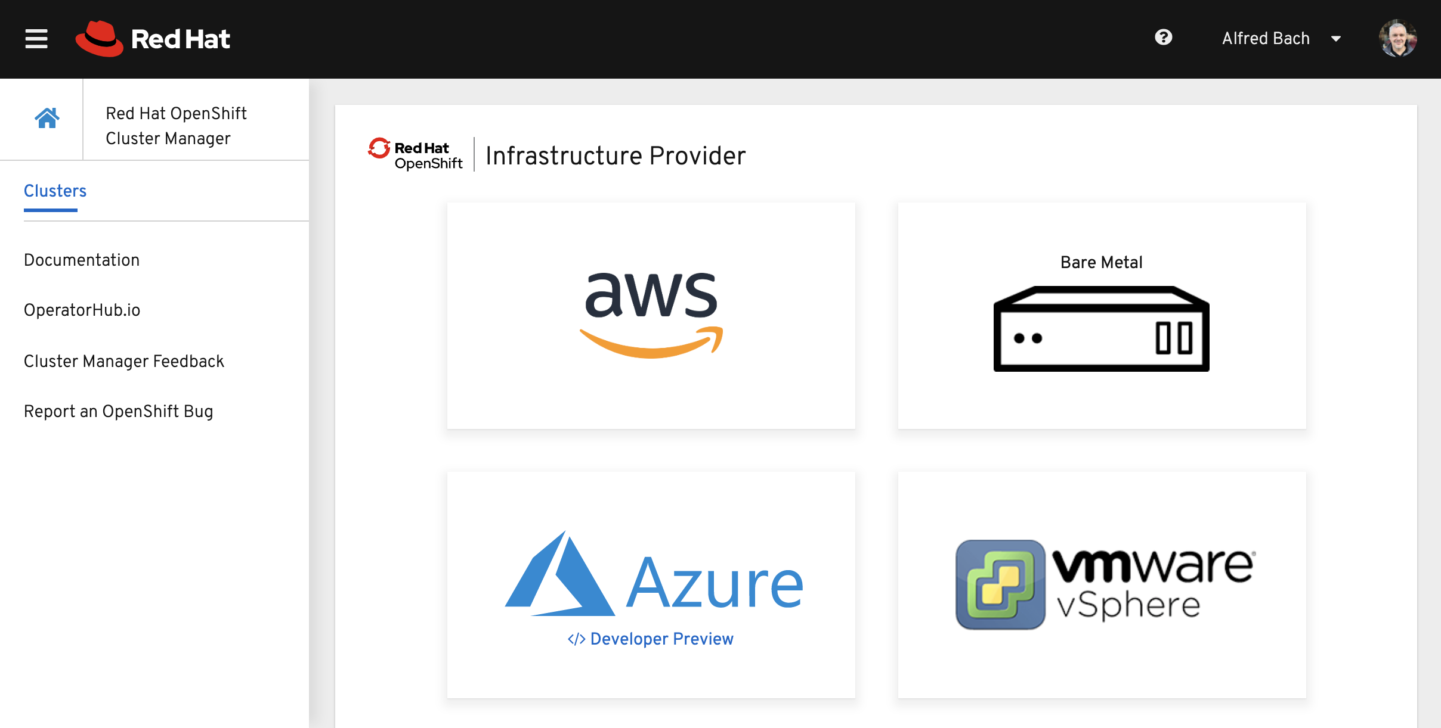
Virtual Environments

Slide 13
Subscriptons

Slide 14
Hubscribe an OpenShift 4 cluster
RHEL
OCS 2 CORE
OCS 2 CORE
CNS
Deployment Server
RHEL 8
OCS 2 CORE
OCS 2 CORE
CNS
RHEL
OCS 2 CORE
OCS 2 CORE
CNS
Load Balacer
RHEL 8 HAPROXY BIND
OCS 2 CORE
Control Plane
CoreOS
3 Master Nodes
Registry
Worker Nodes
RHEL 7 or ATOMIC
CNS (Optional)
Container Native Storage (CEPH)
RHEL 7 or ATOMIC
DIrect att. Disk
Boot Strap
CoreOS

Slide 15
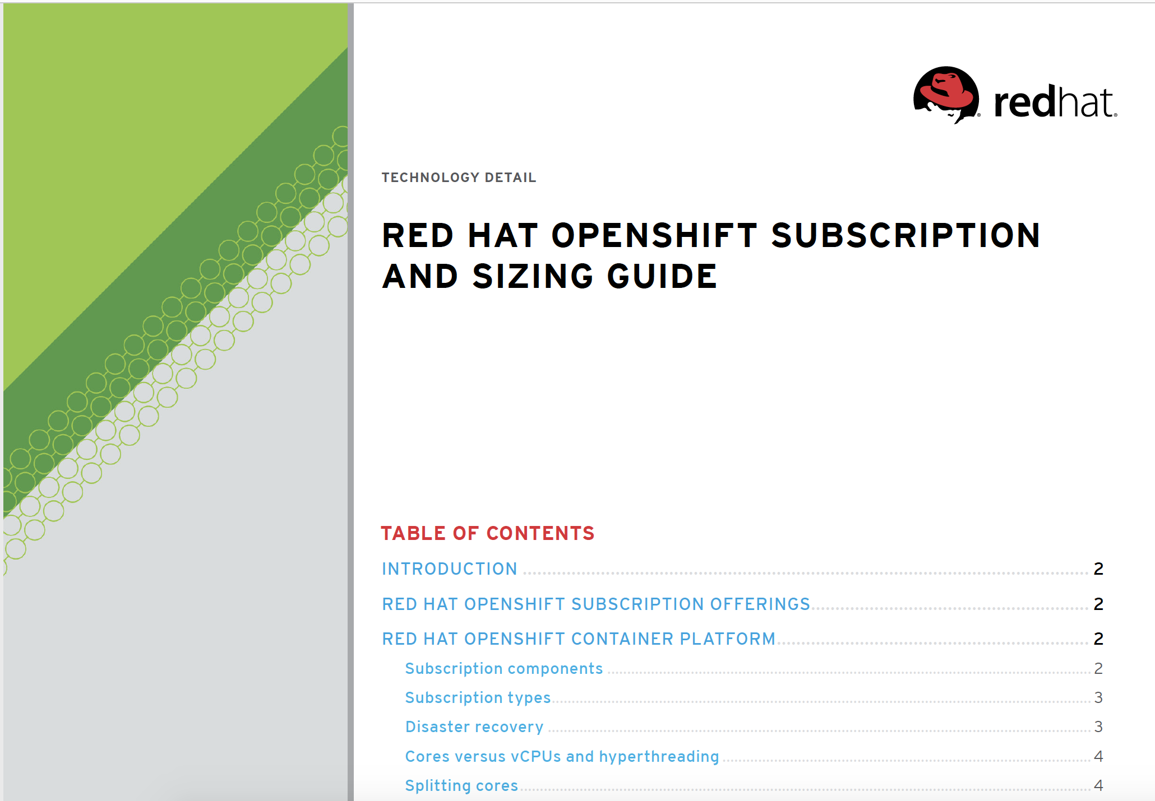
OPENSHIFT
SUBSCRIPTION
GUIDE:
CORPORATE SLIDE TEMPLATES

Slide 16
Thank you
Red Hat is the world’s leading provider of enterprise open source software solutions. Award-winning support, training, and consulting services make Red Hat a trusted adviser to the Fortune 500.

